Slide 1
YouTube i youtuberi

Slide 2
Joomboos

Slide 3
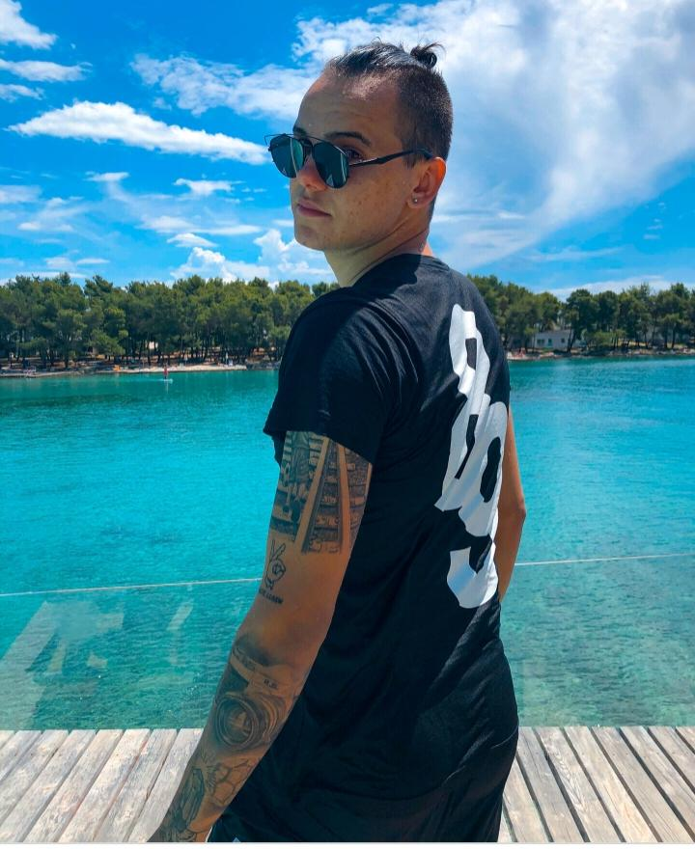
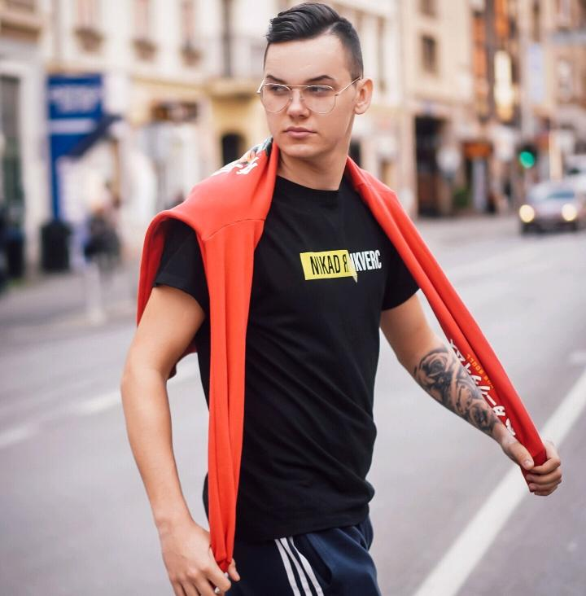
8rasta9

Slide 4
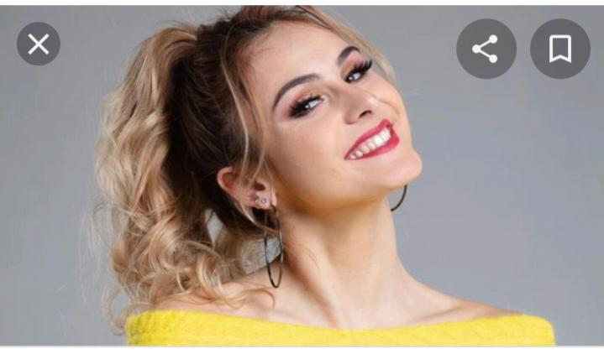
Xniks2x

Slide 5
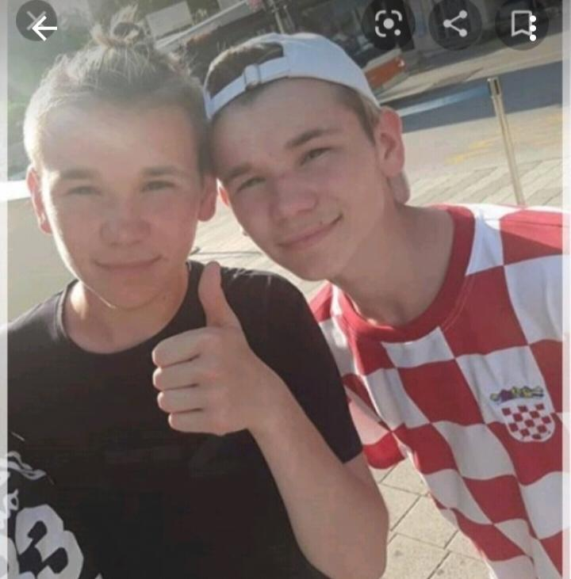
Marcus i martinus

